Slide 1
Creating Data Flow Diagrams

Slide 2

Data Flow Diagrams Symbols
DeMarco & Yourdon
System Analysis and Design
System – a group of interrelated procedures used for a business function, with an identifiable boundary, working together for some purpose.
Source/ Sink
Analysis – separation of a whole into its component parts
0.0
Process
Design – to create, fashion, execute, or construct according to plan
DATA STORE
Physical Data Flow Diagrams – show how the current system flows
Logical Data Flow Diagrams – show the data flow, structure, and requirements of a new system
Data Flow Lines

Slide 3
Data Flow Diagrams Symbols
DeMarco & Yourdon
Source/Sink – help to establish the boundaries of the system. A source identifies the origin of data inflow to the system. A sink identifies the outflow of a system, many times as information.
Sometimes referred to an entity, a source may be a customer, vendor, employee, or even another system. A single entity can be both a source and a sink.
Source/ Sink
0.0
Process
DATA STORE
Data Flow Lines

Slide 4
Data Flow Diagrams Symbols
DeMarco & Yourdon
Processes – are the activities (manual and automated) that transform the inputs, transport data from process to process, stores the data, and produce the outputs of a system.
Processes are used on every DFD starting with an over all process on the context level diagram, the system. The system is then decomposed until a primitive level is obtained. The primitive level is the point in which the relevant activities of a process are identified.
Source/ Sink
0.0
Process
DATA STORE
Data Flow Lines

Slide 5
Data Flow Diagrams Symbols
DeMarco & Yourdon
Data Store – is the resting place of the data in a system. A data store can be in the form of paper, a disk file or any other media.
Normally the word ‘data’ does not appear in the title of a data store. Some examples of data stores are Customer Order, Payment, Invoice, Time Card……
Source/ Sink
0.0
Process
DATA STORE
Data Flow Lines

Slide 6
Data Flow Diagrams Symbols
DeMarco & Yourdon
Data Flow – is the data in motion. Data can move from the outside (source) into a process. Once the inside of a system data must flow from place to place through a process, the flow lines show this movement.
The lines are labeled to provide clarity and meaning to the data moving through the system.
Source/ Sink
0.0
Process
DATA STORE
Data Flow Lines

Slide 7
Data Flow Diagrams Levels
DeMarco & Yourdon
Context Level DFD
Source/ Sink
Source/ Sink
0.0
Process
Source/ Sink
Data Flow
Data Flow
Data Flow
Level 0 DFD
0.0
Process
1.0
Process
Data Flow
Data Flow
Data Flow
DATA STORE
Source/ Sink
2.0
Process
Source/ Sink
Data Flow
Data Flow
Data Flow Lines
Data Flow
3.0
Process
Data Flow

Slide 8
Data Flow Diagrams Levels
DeMarco & Yourdon
Source
Level 1 DFD (and on)
Source/ Sink
Data Flow
1.1
Process
DATA STORE
0.0
Process
Source
1.2
Process
Data Flow
DATA STORE
Data Flow
Data Flow Lines
Sink

Slide 9
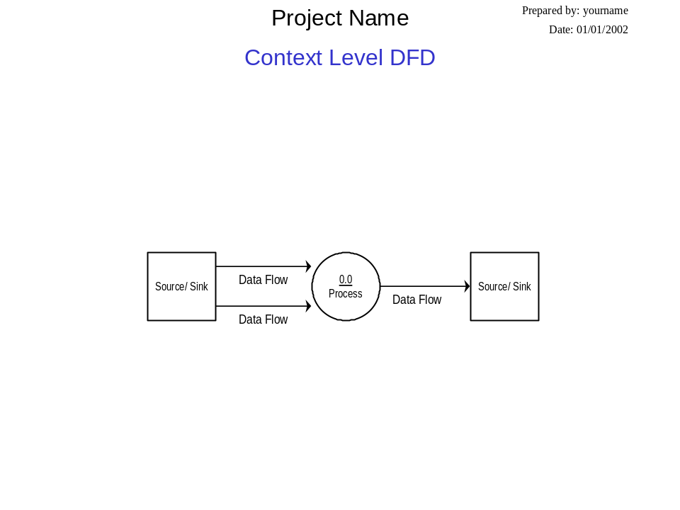
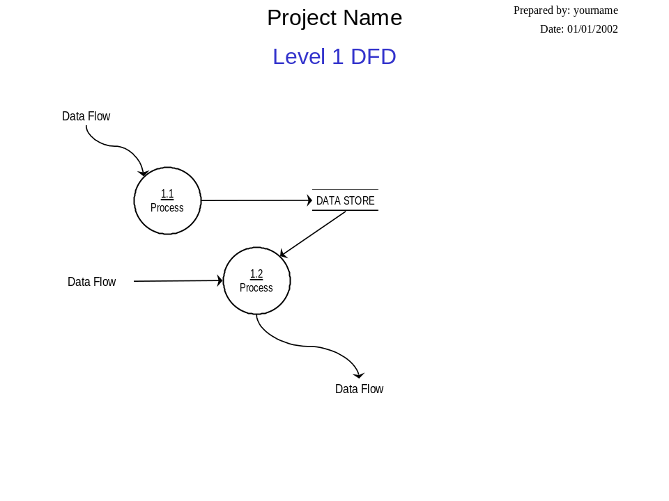
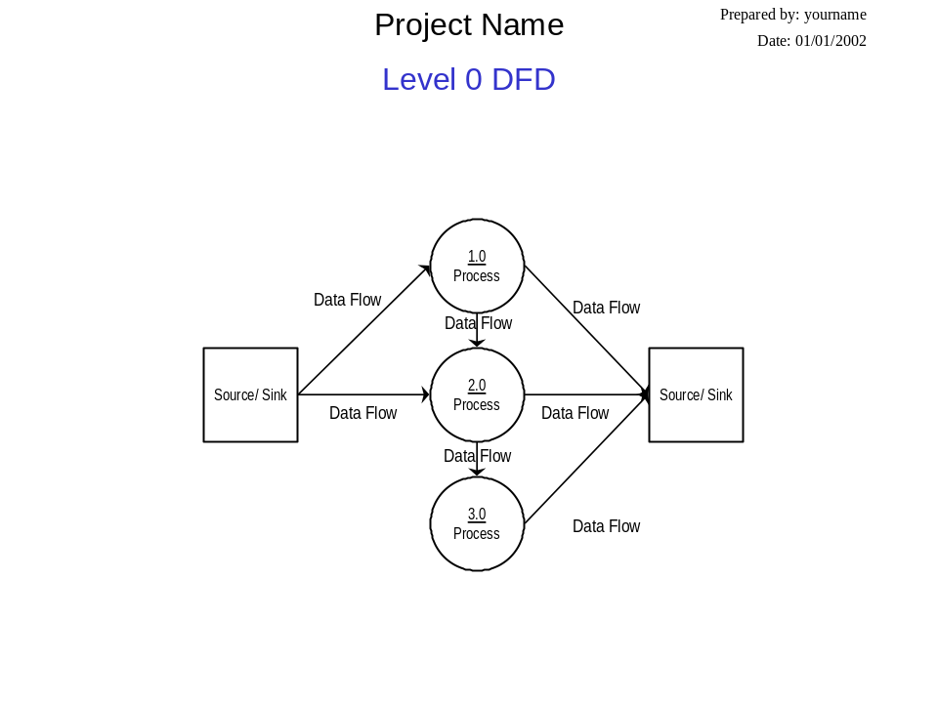
Data Flow Diagrams Levels

Slide 10
Creating Data Flow Diagrams
Steps:
Create a list of activities
Construct Context Level DFD
(identifies sources and sink)
Construct Level 0 DFD
(identifies manageable sub process )
Construct Level 1- n DFD
(identifies actual data flows and data stores )

Slide 11

Creating Data Flow Diagrams
Lemonade Stand Example

Slide 12
Creating Data Flow Diagrams
Example
Steps:
The operations of a simple lemonade stand will be used to demonstrate the creation of dataflow diagrams.
Create a list of activities
Construct Context Level DFD
(identifies sources and sink)
Construct Level 0 DFD
(identifies manageable sub processes )
Construct Level 1- n DFD
(identifies actual data flows and data stores )

Slide 13
Creating Data Flow Diagrams
Example
Create a list of activities
Think through the activities that take place at a lemonade stand.
Customer Order
Serve Product
Collect Payment
Produce Product
Store Product

Slide 14
Creating Data Flow Diagrams
Example
Create a list of activities
Also think of the additional activities needed to support the basic activities.
Customer Order
Serve Product
Collect Payment
Produce Product
Store Product
Order Raw Materials
Pay for Raw Materials
Pay for Labor

Slide 15
Creating Data Flow Diagrams
Example
Create a list of activities
Group these activities in some logical fashion, possibly functional areas.
Customer Order
Serve Product
Collect Payment
Produce Product
Store Product
Order Raw Materials
Pay for Raw Materials
Pay for Labor

Slide 16

Creating Data Flow Diagrams
Example
Construct Context Level DFD
(identifies sources and sink)
Create a context level diagram identifying the sources and sinks (users).
Context Level DFD
CUSTOMER
0.0
Lemonade System
Sales Forecast
EMPLOYEE
Order
Customer Order
Serve Product
Collect Payment
Produce Product
Store Product
Order Raw Materials
Pay for Raw Materials
Pay for Labor
Production Schedule
Product Served
Pay
Payment
Time Worked
Received Goods
Payment
Purchase Order
VENDOR

Slide 17
Creating Data Flow Diagrams
Example
Construct Level 0 DFD
(identifies manageable sub processes )
Create a level 0 diagram identifying the logical subsystems that may exist.
Level 0 DFD
1.0
Sale
Customer Order
Serve Product
Collect Payment
Produce Product
Store Product
Order Raw Materials
Pay for Raw Materials
Pay for Labor
Customer Order
Sales Forecast
Product Ordered
CUSTOMER
Payment
2.0
Production
EMPLOYEE
Production
Schedule
Product Served
Received Goods
Inventory
VENDOR
3.0
Procure-ment
Purchase Order
Order
Decisions
Payment
Pay
Time Worked
4.0
Payroll

Slide 18

Creating Data Flow Diagrams
Example
Construct Level 1- n DFD
(identifies actual data flows and data stores )
Create a level 1 decomposing the processes in level 0 and identifying data stores.
Level 1 DFD
CUSTOMER
Customer Order
Customer Order
Serve Product
Collect Payment
Produce Product
Store Product
Order Raw Materials
Pay for Raw Materials
Pay for Labor
ORDER
Request for Forecast
1.1
Record Order
1.3
Produce Sales Forecast
Severed Order
Payment
Sales Forecast
1.2
Receive Payment
PAYMENT

Slide 19

Creating Data Flow Diagrams
Example
Construct Level 1 (continued)
Create a level 1 decomposing the processes in level 0 and identifying data stores.
Level 1 DFD
Product Order
ORDER
Customer Order
Serve Product
Collect Payment
Produce Product
Store Product
Order Raw Materials
Pay for Raw Materials
Pay for Labor
2.1
Serve Product
Quantity Severed
RAW MATERIALS
Production
Schedule
2.2
Produce Product
Quantity Used
INVENTORTY
Production Data
2.3
Store
Product
Quantity Produced & Location Stored

Slide 20


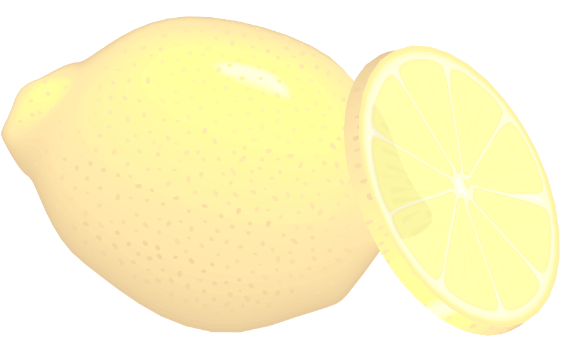
Creating Data Flow Diagrams
Example
Construct Level 1 (continued)
Create a level 1 decomposing the processes in level 0 and identifying data stores.
Level 1 DFD
Order Decision
3.1
Produce Purchase Order
PURCHASE ORDER
Customer Order
Serve Product
Collect Payment
Produce Product
Store Product
Order Raw Materials
Pay for Raw Materials
Pay for Labor
Quantity On-Hand
RAW MATERIALS
Quantity
Received
Received Goods
3.2
Receive Items
RECEIVED ITEMS
Payment Approval
3.3
Pay Vendor
VENDOR
Payment

Slide 21

Creating Data Flow Diagrams
Example
Construct Level 1 (continued)
Create a level 1 decomposing the processes in level 0 and identifying data stores.
Level 1 DFD
Time Worked
4.1
Record Time Worked
TIME CARDS
Customer Order
Serve Product
Collect Payment
Produce Product
Store Product
Order Raw Materials
Pay for Raw Materials
Pay for Labor
Employee ID
EMPLOYEE
Payroll Request
4.2
Calculate Payroll
Unpaid time cards
PAYROLL
Payment Approval
4.3
Pay Employee
PAYMENTS
Payment

Slide 22
Process Decomposition
1.0
Sale
1.1
Record Order
1.2
Receive Payment
2.0
Production
2.1
Serve Product
2.2
Produce Product
2.3
Store
Product
0.0
Lemonade System
3.0
Procure-ment
3.1
Produce Purchase Order
3.2
Receive Items
3.3
Pay Vendor
4.0
Payroll
4.1
Record Time Worked
4.2
Calculate Payroll
4.3
Pay Employee
Context Level
Level 0
Level 1

Slide 23
Creating Data Flow Diagrams
Lemonade Stand Example
END

